Slide 1
CAPSTONE PROJECT-01
CUSTOMER DATA ANALYSIS
PTID-CDA-OCT-25-803
PROJECT ID: PRDA-05 CUSTOMER DATA ANALYSIS
ADITYA HINGRAJIYA

Slide 2
INTRODUCTION
In today’s competitive business landscape, understanding customer behavior is crucial for boosting sales and enhancing customer experience. This project analyzes customer data from multiple shopping malls, covering demographics, product categories, purchase details, and payment methods. Using SQL, key insights were extracted on gender-wise purchasing, category preferences, and age-based buying trends. Power BI dashboards were developed to visualize patterns such as top products, preferred payment modes, and mall-wise revenue. These insights enable businesses to improve targeted marketing, optimize inventory, refine pricing strategies, and strengthen customer engagement.

Slide 3
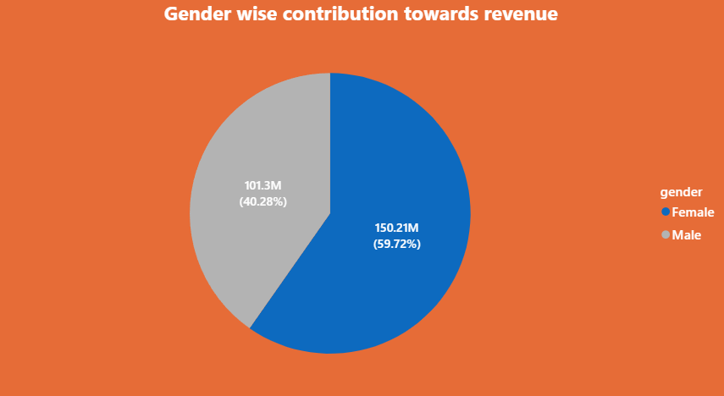
This gap indicates potential to boost male engagement.
Females lead revenue by nearly 19%, likely driven by female-focused categories.
Targeted marketing can maintain devoted female clients while balancing contributions.

Slide 4
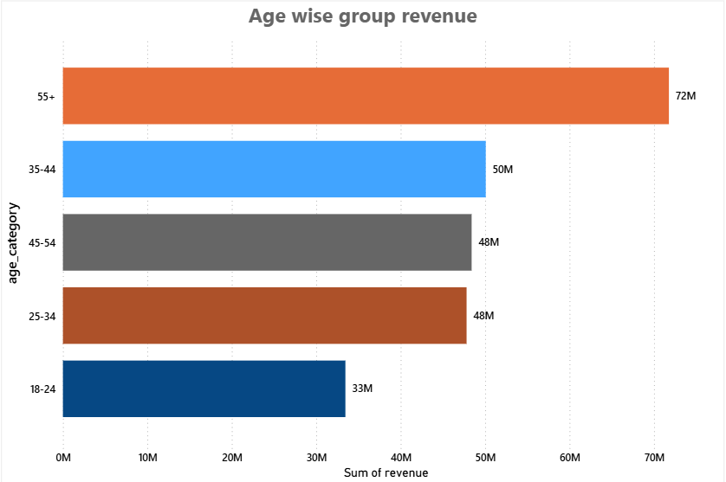
The largest revenue contributors (72M) are customers over the age of 55, demonstrating a strong purchasing power in this market.
Middle-aged groups (25–54) consistently contribute between 48 and 50 million, demonstrating consistent purchasing patterns.
The fact that younger consumers (18–24) make the least contribution points to a chance to create deals that appeal to these consumers.

Slide 5
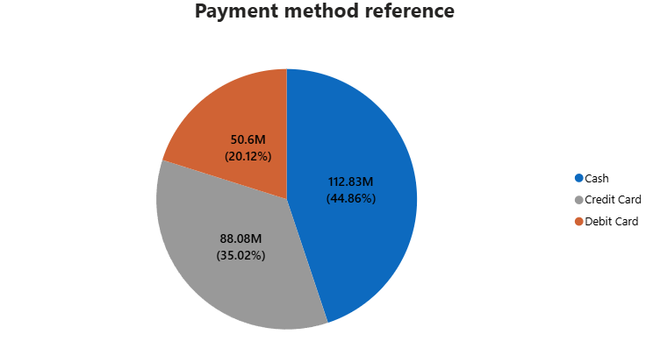
Cash continues to be the most popular payment method, accounting for almost 45% of all transactions.
As consumers become more accustomed to using digital payments, credit cards come in second at 35%.
Only 20% of transactions are made with debit cards, indicating the possibility of promoting digital incentives or card-based offers.

Slide 6
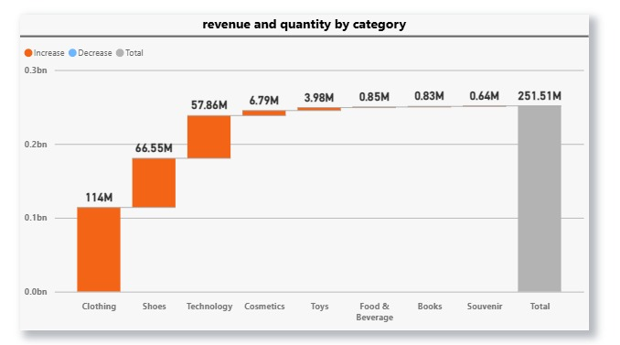
CUMULATIVE CATEGORY
CONTRIBUTION

Slide 7
Cumulative category contribution helps identify which product segments produce the highest share of revenue.
Clothing, shoes, and technology together account for the majority of total revenues, in line with the 80/20 contribution pattern.
Toys and cosmetics have moderate but fairly consistent revenue potential; these, too, are secondary contributors.
Emphasize the high-generating categories and simultaneously improve the lower ones with strategic moves for increasing efficiency and profitability.

Slide 8
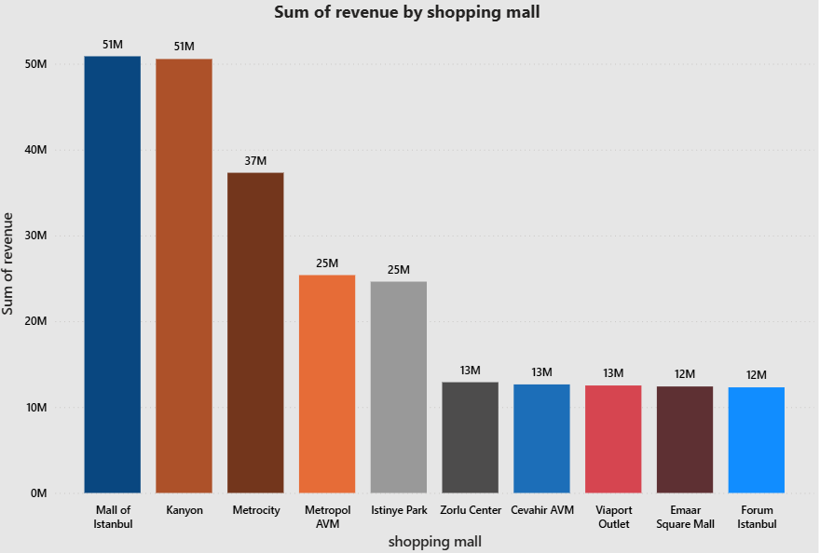
Revenue Performance by Shopping mall
With over ₹50M revenue, Mall of Istanbul and Kanyon are in first place, demonstrating the highest levels of brand presence and consumer engagement.
Metrocity comes in second with a moderate performance (~37M), and the mid-tier group is made up of Metropol AVM and Istinye Park (~25M).
Malls with lower revenue (less than ₹13M) suggest fewer customers or less spending.
Revenue distribution shows that top malls dominate the market; concentrating marketing efforts and customer service in mid-tier malls can enhance the overall balance of sales.

Slide 9
1. Compared to female customers, male customers generate more overall revenue, indicating stronger purchasing activity.
2. The most lucrative market segment is senior customers (55+), who exhibit greater brand loyalty and spending power.
3. Although the use of digital payments is steadily growing, cash payments are still the most popular option.
4. The Pareto principle (80/20 rule) the majority of profits come from a small number of key products, is confirmed by the fact that a few top categories dominate total revenue.
5. Due to their high customer traffic and purchase volume, the Mall of Istanbul and Kanyon stand out as the top revenue generators.
6. Overall, the business shows concentrated revenue sources, by targeting underperforming malls, younger age groups, and female customers, total revenue can grow significantly.
CONCLUSION

Slide 10
SUGGESTIONS
1. Focus on High-Value Markets
Concentrate marketing efforts on female and 25–35 age group customers, as they generate more engagement and revenue.
2. Advance Electronic Payments
To lessen reliance on cash payments, promote card and wallet transactions with cashback or discount offers.
3. Product Category Optimization
To optimize profit, give priority to the marketing and stocking of the top 20% categories as determined by Pareto analysis.
4. Improve Mall Efficiency
To balance overall revenue, apply tactics from top-performing malls (e.g., promotions, events) to other locations.
5. Increase Client Loyalty
To improve retention and long-term value, implement loyalty and referral programs for regular clients.

Slide 11
THANK
YOU!

